Slide 1
Final Report : Capstone Project The Battle of Neighborhoods & Finding a better place to live and better school to attend

Slide 2
Introduction:
In this Project, assuming that families are looking for buying a house with limited budget , also they want to get best school district according to this budget.
We will try to provide with information to the families who are looking for a neighborhood where will fit their financial plan and school expectations. To do so, we will be seeking for neighborhoods in Scarborough, Toronto. in the end; they will be receiving information about the following:
House pricing,
School district rating.
In addition, information about different venues and places for each neighborhood . This will help them to eliminate some neighborhoods where they do not find convenient for the needs of children.
By using all the information above, they will be making the best decision for the future for purchasing a house.

Slide 3
Data:
The data from Week-3 will be used to begin the project .
https://en.wikipedia.org/wiki/List_of_postal_codes_of_Canada:_M
First, we will be using libraries such as Pandas, Geocoder, Beautiful Soup, Folium etc. to determine the target neighborhoods.
Then, the project will be using Foursquare API to give every details about each neighborhood such as number of grocery stores, gas station, restaurants, hospital, house pricing and school district .
Our data will contains:
House Pricing
Map of Scarborough
Cluster for School District rating
Venues for each neighborhood

Slide 4
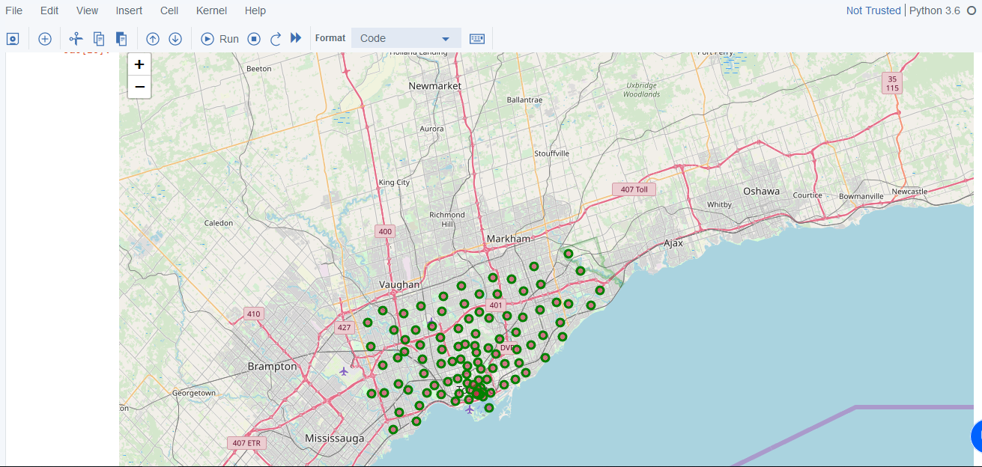

Slide 5
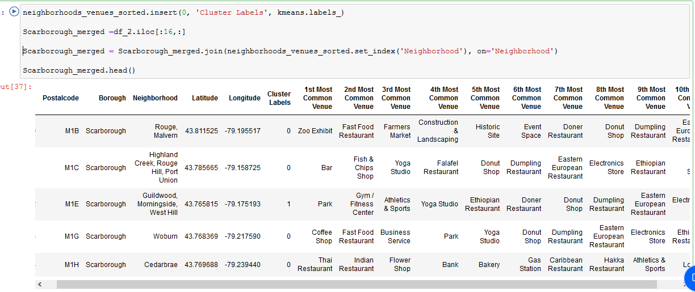
Methodology Section
Clustering Approach:
K-Means Clustering Approach

Slide 6
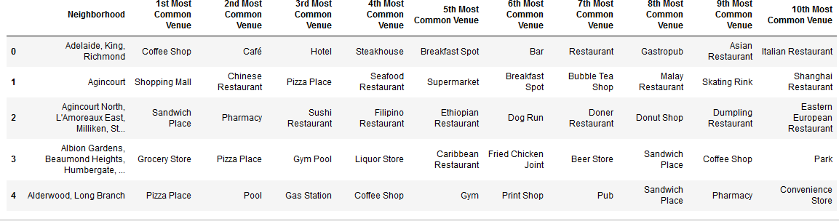
Venues in The neighborhood:

Slide 7
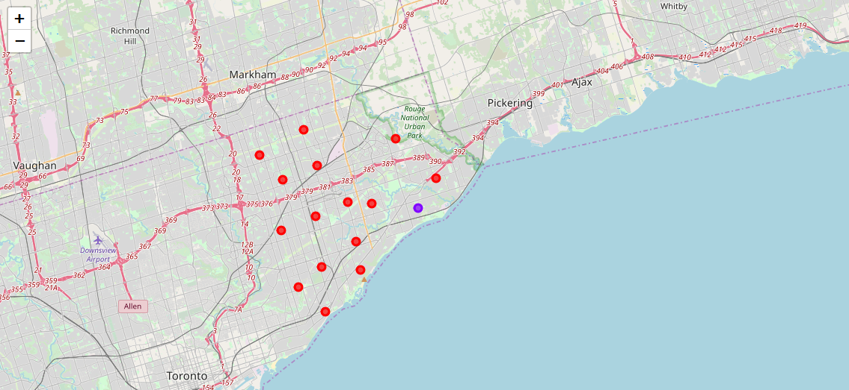
Result Clusters in Scarborough

Slide 8
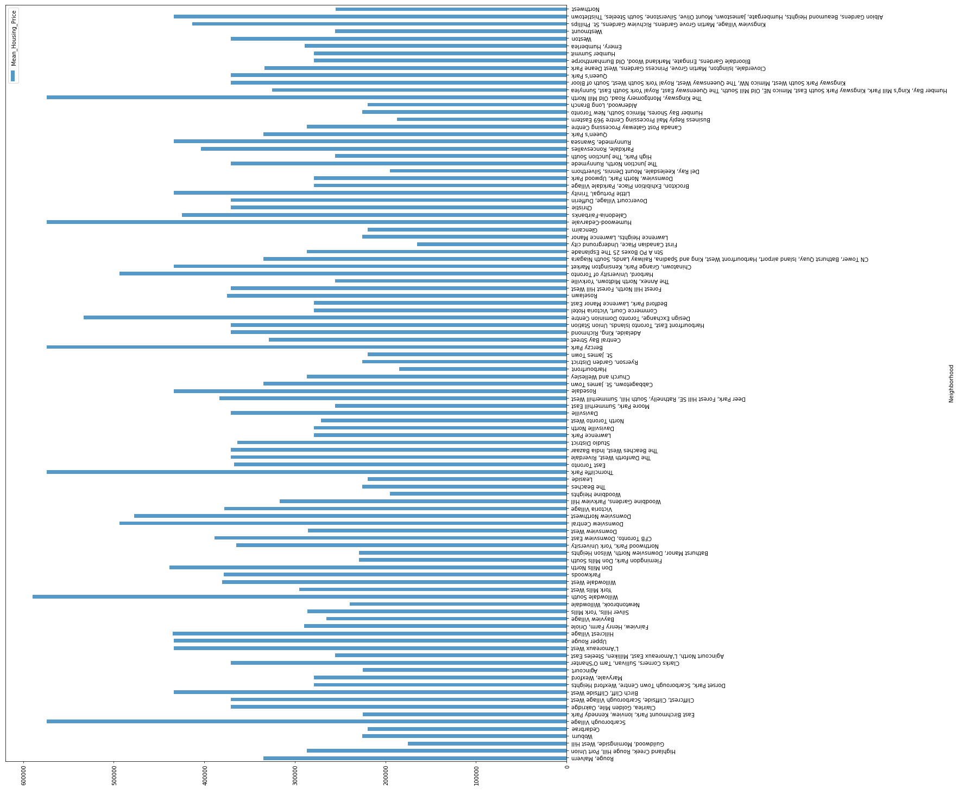
Average Housing Price by Clusters in Scarborough

Slide 9
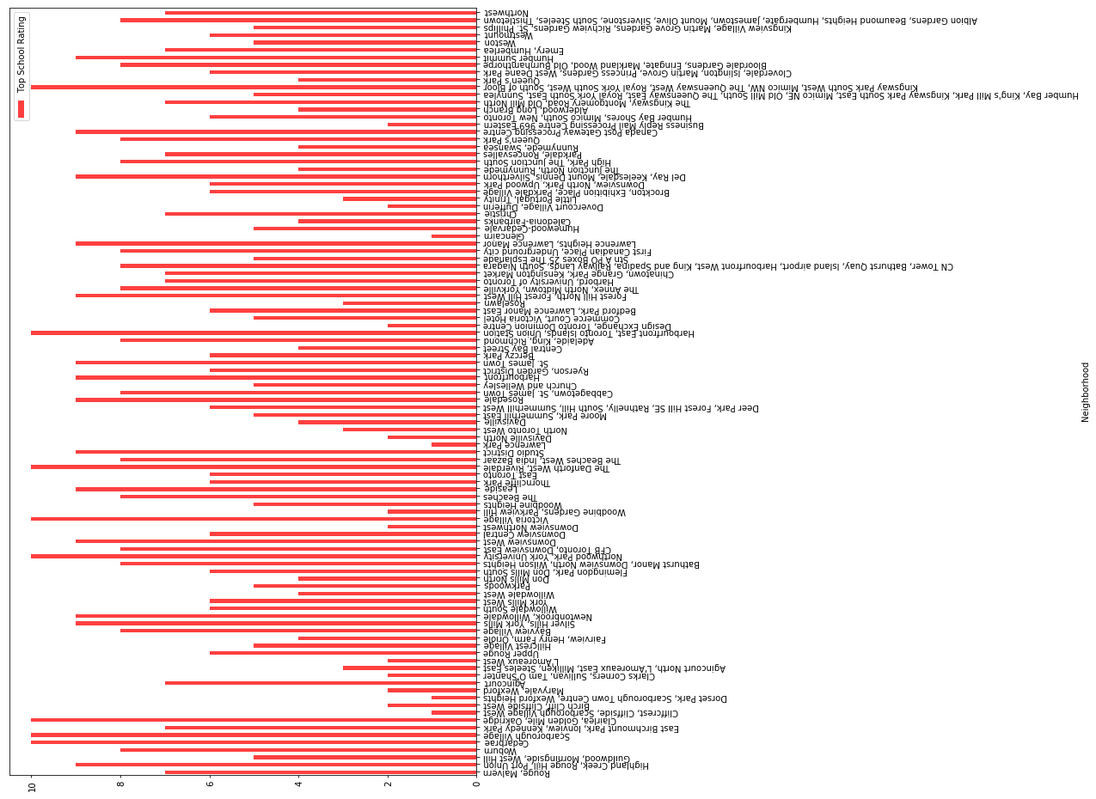
School Ratings in Scarborough

Slide 10
Conclusion Section
In this project, using k-means cluster algorithm we separated the neighborhood into 10(Ten) different clusters and for 103 different latitude and longitude from dataset, which have very-similar neighborhoods around them. Using the charts above results presented to a particular neighborhood based on average house prices and school rating have been made. . According to school rating and house pricing Cabbage Town , East Toronto and West Riverdale would be great choice for families to buy house and find a high rating school for the kids

